Slide 1

Automatic Speech Recognition
Towards understanding deep networks
Louis ten Bosch
Radboud University Nijmegen, NL

Slide 2
ASR is a dynamic field.
Topics and techniques are changing rapidly.

Slide 3
ASR is a dynamic field.
Topics and techniques are changing rapidly.
ASR is a broad field.
We only discuss the main issues.

Slide 4
Time line of this course
intro
exp sel
experiments
thesis
round up
now mid Dec

Slide 5
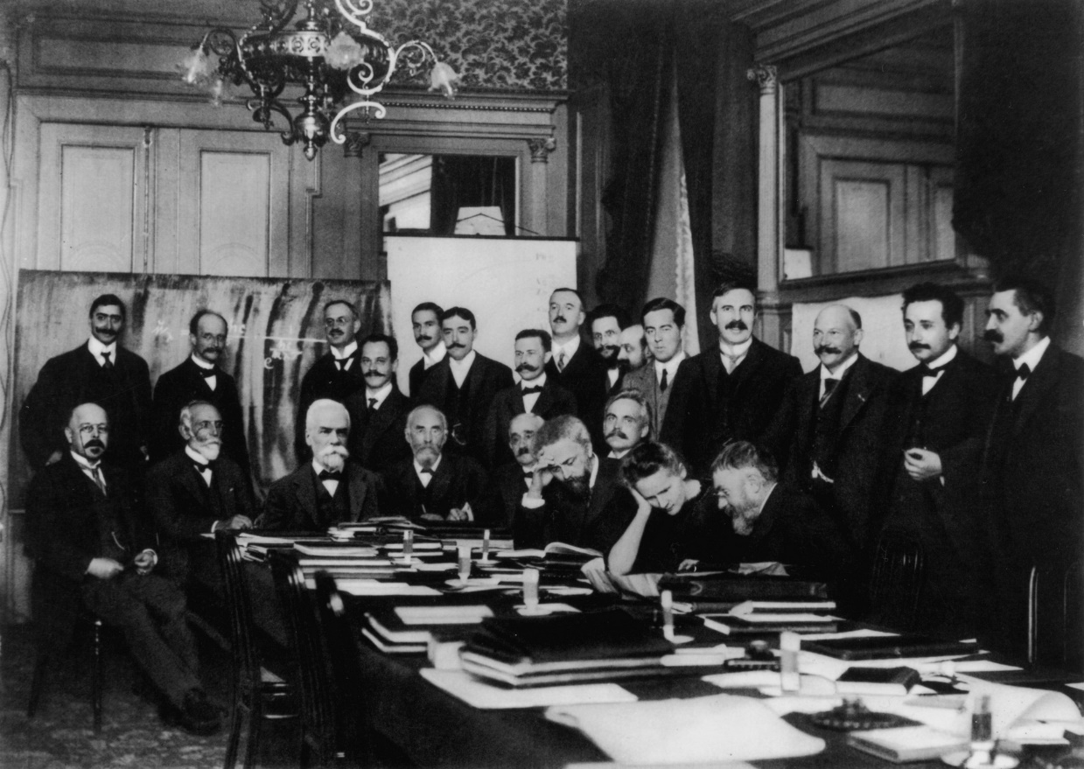

Audience?
For now:
AI
Data Science
Linguistics
…

Slide 6
Reading material
Books
  Classical ASR: Holmes & Holmes
  Jurafsky and Martin: https://web.stanford.edu/~jurafsky/slp3/
Papers: the classics (e.g., Vaswani et al., Baevski et al.)
Papers: recent
  large body of recent papers, e.g. https://www.isca-archive.org/interspeech_2025/verdini25_interspeech.html
  relevant papers will depend on your ASR experimental project
Presentation slides
  will be updated
Internet
  recent papers + videos

Slide 7
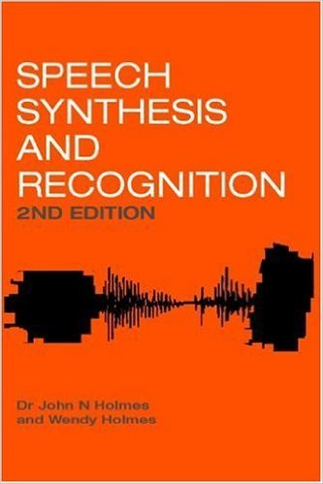
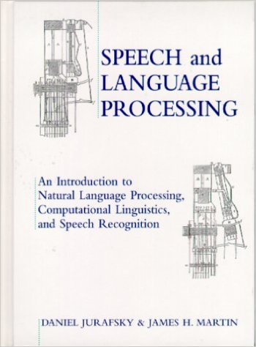
Books – the classical ones

Slide 8
Interspeech tutorial presentations
1. Tutorials - Automatic Quality Assessment for Speech and Beyond [INTERSPEECH 2025 Tutorial] Automatic Quality Assessment for Speech and Beyond
2. Nvidia NeMo toolkit for speech applications
https://drive.google.com/file/d/1hlfFnVNrdHQ_FrvgVJRw4XNszl-aXVUz/view?usp=drivesdk
3. Speech Technology meets early Language acquisition: How interdisciplinary efforts benefit both the fields
https://zenodo.org/records/17018214

Slide 9
Global set-up
Seven weeks, until Dec 14/15
2 (4) contact hours per week
Lectures
Reading material, key papers
Presentations (in small working groups)
Small experiments
  Starting examples
  Addressing your own questions

Slide 10
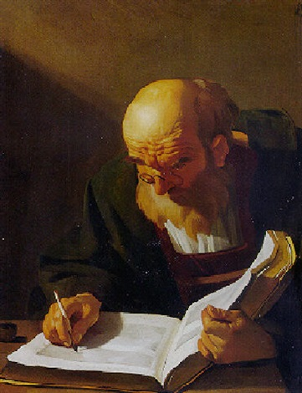
Thesis
Topic:
  ASR is way too broad to be dealt with in a few weeks
  you choose your topic
  based on experimental work
  but may also be theoretical
Experiment: individual or in a group
Writing: always individual
Assessment: individual

Slide 11
human machine interaction
language modelling
speaker recognition
speech processing
dialogue systems
text to speech
speech signal processing

Slide 12
human machine interaction
language modelling
speaker recognition
speech processing
automatic speech recognition
dialogue systems
text to speech
speech signal processing

Slide 13
You
Students: Different educational backgrounds
  Computational linguistics
  Data science
  Other
Working in groups – Real-life approach
Experiments
  You may choose your own topic/experiment
  You may use your own database, or use a standard one from the web

Slide 14
Broad overview
Week | Topic
1-2 | Lecture: Intro, overview Reading
3 | Literature, brainstorm topics for experiment
4 | Literature presentations Determine experimental topics Set-up experiments
5 | Reporting ongoing experiments
6-7 | Groups of 2 or 3: 10-minute presentation Presentations of experimental results Assessment Closing

Slide 15
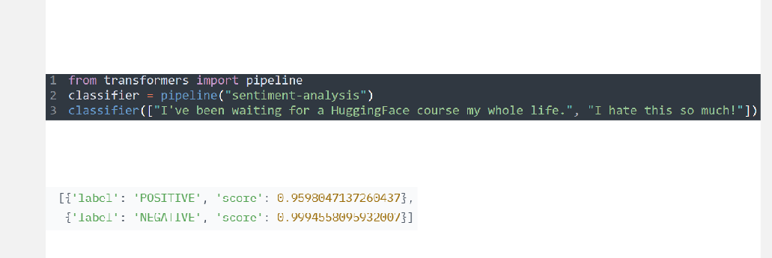
As simple as it can be

Slide 16
Literature
Papers on the web, Xarxiv, etc.
Interspeech
  https://www.isca-archive.org/interspeech_2025/index.html
ICASSP
A number of key papers are given in the course
  Fastly growing
  Additional material may vary – usually depends on your experimental project

